Slide 1
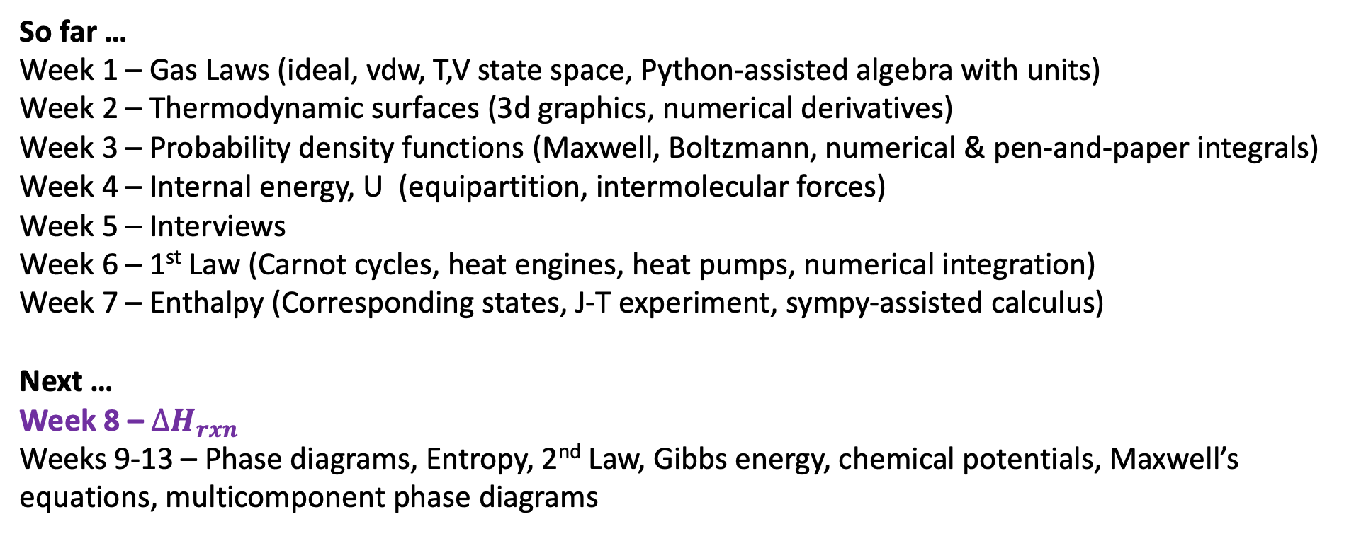
Retrospective and prospective
So far …
Week 1 – Gas Laws (ideal, vdw, T,V state space, Python-assisted algebra with units)
Week 2 – Thermodynamic surfaces (3d graphics, numerical derivatives)
Week 3 – Probability density functions (Maxwell, Boltzmann, numerical & pen-and-paper integrals)
Week 4 – Internal energy, U (equipartition, intermolecular forces)
Week 5 – Interviews
Week 6 – 1st Law (Carnot cycles, heat engines, heat pumps, numerical integration)
Week 7 – Enthalpy (Corresponding states, J-T experiment, sympy-assisted calculus)
Next …
Week 8 – $∆H_{rxn}$
Weeks 9-13 – Phase diagrams, Entropy, 2nd Law, Gibbs energy, chemical potentials, Maxwell’s equations, multicomponent phase diagrams

Slide 2
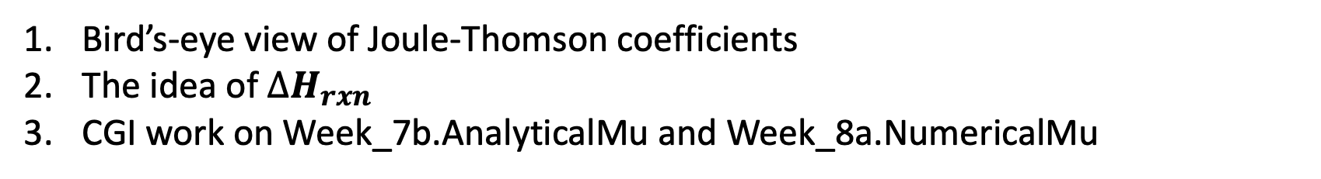
Today
Bird’s-eye view of Joule-Thomson coefficients
The idea of $∆H_{rxn}$
CGI work on Week_7b.AnalyticalMu and Week_8a.NumericalMu

Slide 3
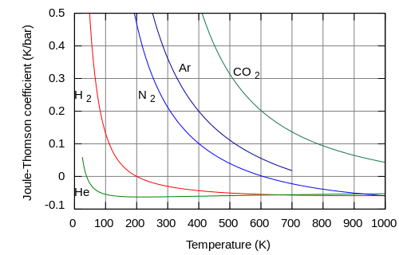
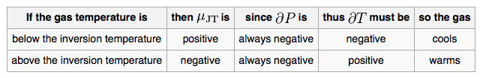
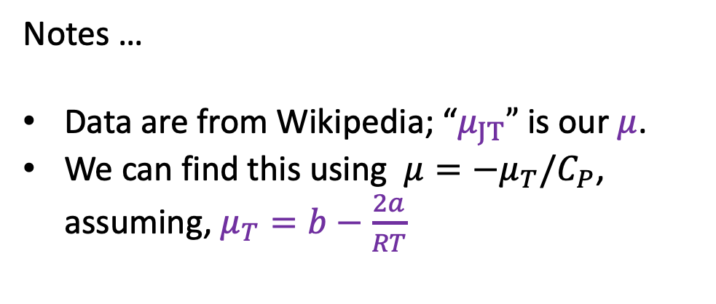
Bird’s-eye view of Joule-Thomson coefficients
Notes …
Data are from Wikipedia; “$μ_{JT}”$ is our $μ$.
We can find this using ${μ=−μ}_{T}/C_{P}$, assuming, $μ_{T}=b−\frac{2a}{RT}$

Slide 4
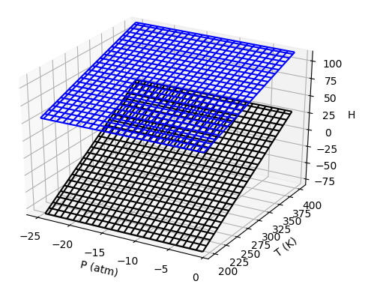
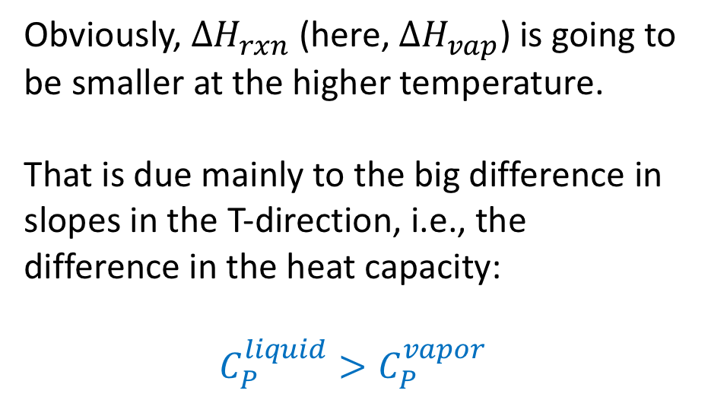
$∆H_{rxn}$: Qualitative
Upper surface (product) is vapor
Lower surface (reactant) is liquid
Obviously, $∆H_{rxn}$ (here, $∆H_{vap}$) is going to be smaller at the higher temperature.
That is due mainly to the big difference in slopes in the T-direction, i.e., the difference in the heat capacity:
$$C_{P}^{liquid}>C_{P}^{vapor}$$

Slide 5
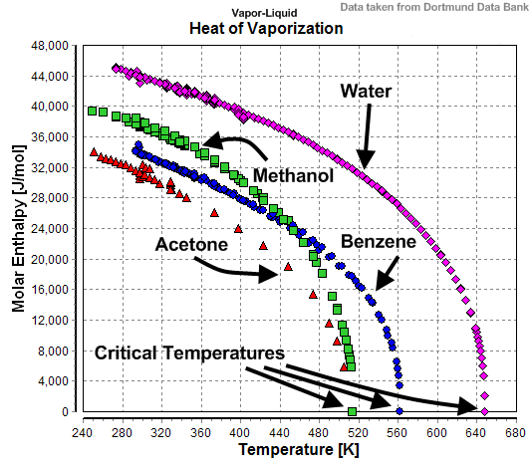
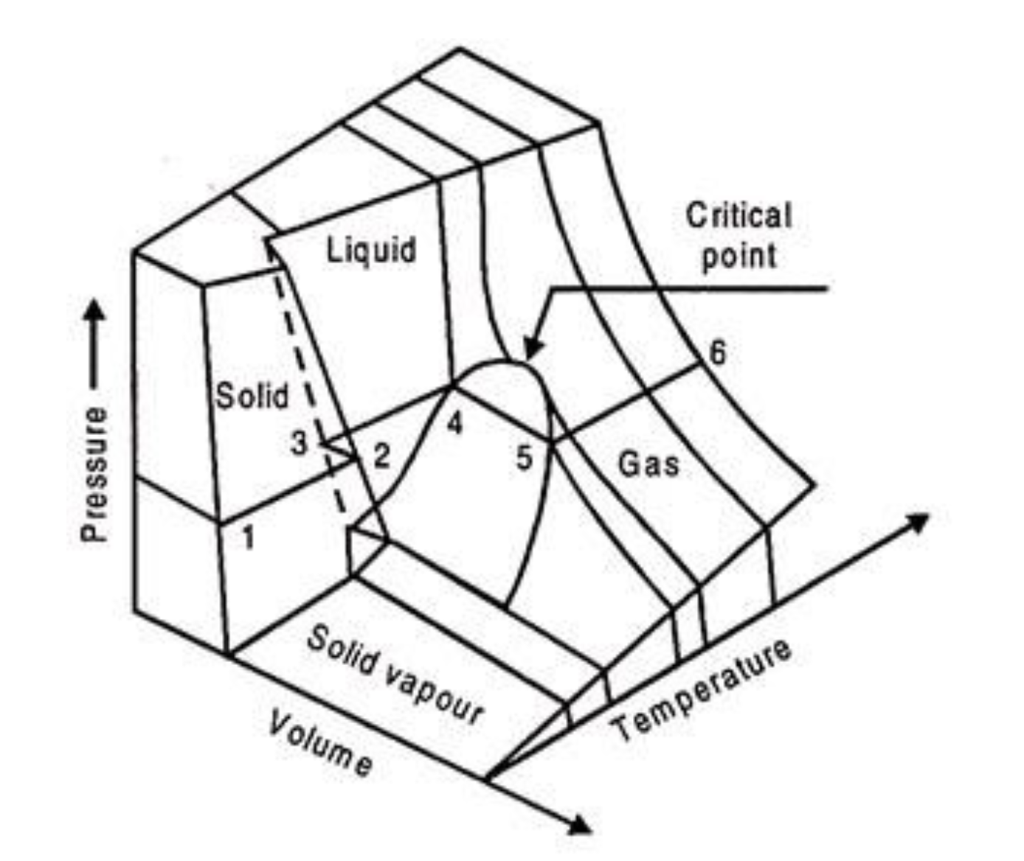
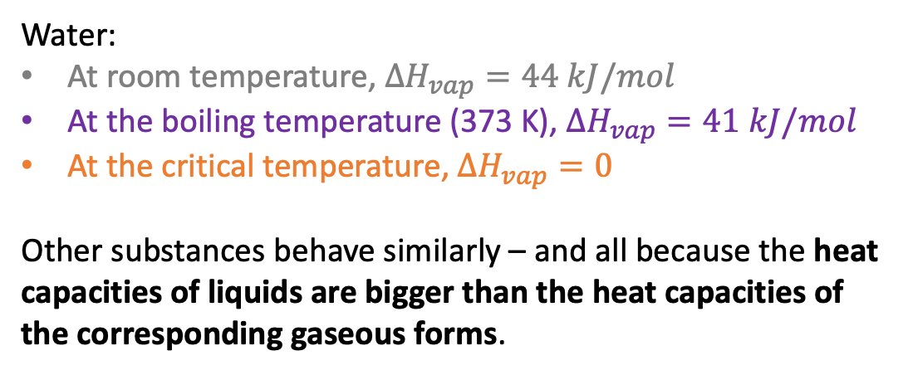

$∆H_{vap}$: Observations
Water:
At room temperature, $∆H_{vap}=44 kJ/mol$
At the boiling temperature (373 K), $∆H_{vap}=41 kJ/mol$
At the critical temperature, $∆H_{vap}=0$
Other substances behave similarly – and all because the heat capacities of liquids are bigger than the heat capacities of the corresponding gaseous forms.
Is there a molecular perspective on this?
Generic $P(T,V)$

Slide 6
$∆H_{vap}$: Observations
Water:
At room temperature, $∆H_{vap}=44 kJ/mol$
At the boiling temperature (373 K), $∆H_{vap}=41 kJ/mol$
At the critical temperature, $∆H_{vap}=0$
Other substances behave similarly – and all because the heat capacities of liquids are bigger than the heat capacities of the corresponding gaseous forms.
Generic $P(T,V)$

Slide 7
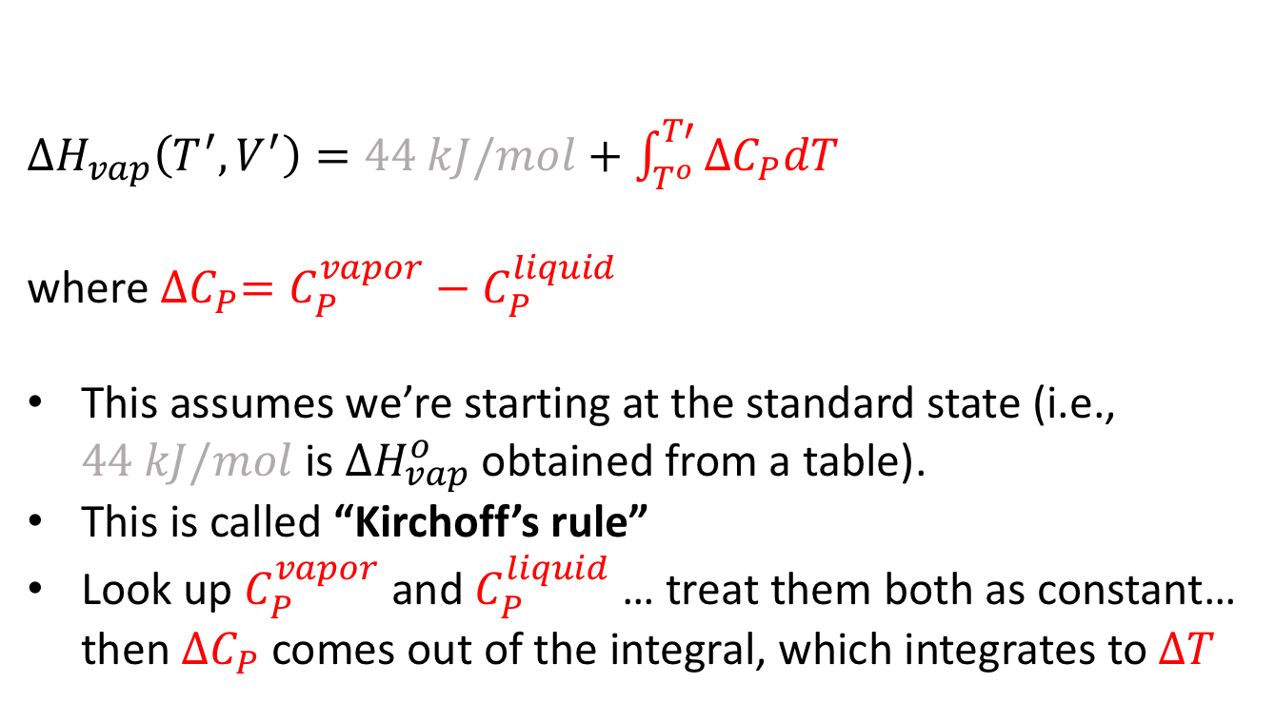
$∆H_{rxn}$: Kirchoff’s rule
$∆H_{vap}\left(T^{′},V^{′}\right)=44 kJ/mol+\int_{T^{o}}^{T′}{{∆C}_{P}dT}$
where ${∆C}_{P}=C_{P}^{vapor}−C_{P}^{liquid}$
This assumes we’re starting at the standard state (i.e., $44 kJ/mol$ is $∆H_{vap}^{o}$ obtained from a table).
This is called “Kirchoff’s rule”
Look up $C_{P}^{vapor}$ and $C_{P}^{liquid}$ … treat them both as constant… then ${∆C}_{P}$ comes out of the integral, which integrates to $∆T$

Slide 8
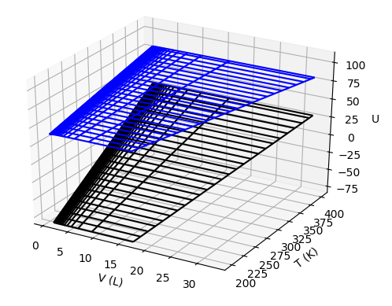
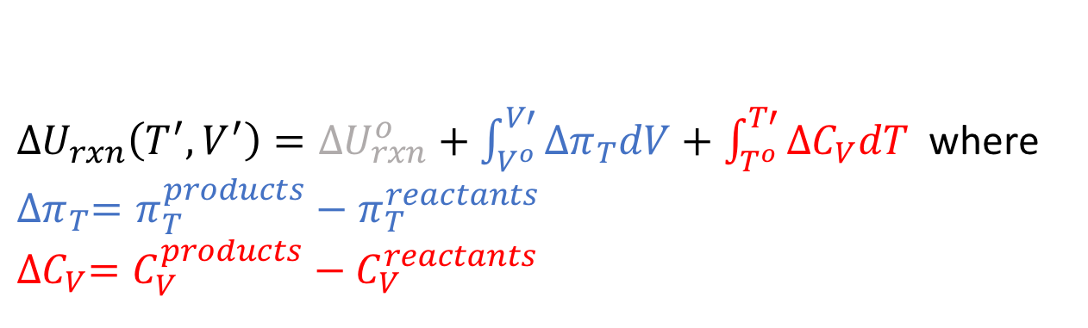
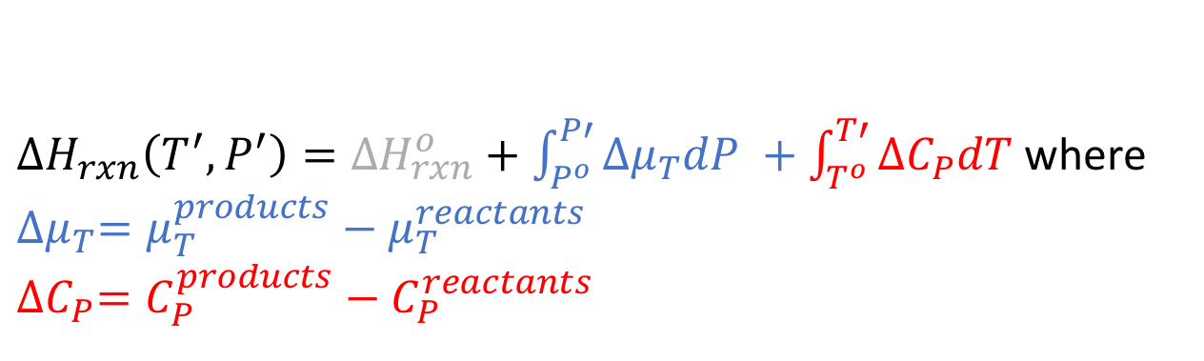
Generalized Kirchoff’s rule
$∆H_{rxn}\left(T^{′},P^{′}\right)=∆H_{rxn}^{o}+\int_{P^{o}}^{P′}{{∆μ}_{T}dP +\int_{T^{o}}^{T′}{{∆C}_{P}dT}}$ where
${∆μ}_{T}=μ_{T}^{products}−μ_{T}^{reactants}$
$${∆C}_{P}=C_{P}^{products}−C_{P}^{reactants}$$
$∆U_{rxn}\left(T^{′},V^{′}\right)=∆U_{rxn}^{o}+\int_{V^{o}}^{V′}{{∆π}_{T}dV}+\int_{T^{o}}^{T′}{{∆C}_{V}dT}$ where
$${∆π}_{T}=π_{T}^{products}−π_{T}^{reactants}$$
$${∆C}_{V}=C_{V}^{products}−C_{V}^{reactants}$$

